Slide 1
Unit – III
Interaction Testing

Slide 2
Modeling for Testing Interactions
We would generate the test cases based on our understanding of the interactions that may happen.
The source is, again, mostly from requirements specification
The timing and place where interactions may occur is often not well specified and become a source of problem ----- thus we need to model

Slide 3
Modeling the Requirements
Concerned with entities (or constructs) interacting with each other
Every requirement spec. must specify these “basic” concepts:
  functions (actions to transform data and control)
  data
  events (triggers)
  ports (device or source/destination of )
  threads (thread := a sequence of activities)
Again, we would also need the “non-functional” (e.g. performance)

Slide 4
A E/R Model of 5 Interacting Entities
(may not be the “ideal” model)
Data
1..n input 1..n
Action
1..n output 1..n
Event
1..n
sequenceOf
1..n
1..n
Thread
occur
1..n
Port
Would knowing these relations help
in designing test cases? ----- minimal?

Slide 5
Interaction “Taxonomy”
Time independent interaction --- static
Time dependent interaction – dynamic
  These may be either on a single processor
  Or span multiple processors
Static - Single processor | Static - Multi processor
Dynamic - Single processor | Dynamic - Multi processor
Most Difficult ?

Slide 6
Modeling Interactions
(may be used for many different purposes)
Static :
  Decision Tables √ √ (you have seen multiple times)
Dynamic Single Processor :
  Finite State Machine √ (modeling the ATM system)
Dynamic Multiple Processors :
  Petri Net (will be introduced in this lesson)

Slide 7
Components of a Decision Table
rules
R1 R2 R3 R4 R5 R6 R7 R8
C1
C2
C3
T T T T F F F F
T T F F T T F F
conditions
values of conditions
T F T F T F T F
a1
a2
a3
a4
a5
x x x x
x x
actions taken
actions
x x
x x x x
x x
R1 says when all conditions are T, then actions a1, a2, and a5 occur ----
Note that this is static; there is NO “time” or “sequence” concept

Slide 8
Triangle Problem Example --- “static” relation
Assume a, b and c are
all between 1 and 200
Pick input <a, b, c> for each of the columns
a < b + c
b < a + c
c < a + b
a = b
a = c
b = c
F T T T T T T T T T T
- F T T T T T T T T T
- - F T T T T T T T T
- - - T T T T F F F F
- - - T T F F T T F F
- - - T F T F T F T F
Not triangle
Scalene
Isosceles
Equilateral
“impossible”
X X X
X
X X X
X
X X X
Note the
Impossible cases

Slide 9
Finite State Machine - a more formal definition
(You have seen this with ATM modeling)
A Finite State Machine is composed of :
  S : a set of states
  S_{i} : a special initial state from the set S
  S_{t} : a subset of S called “accept” or “terminating” states
  I : a set of “input symbols” or “stimulants”
  T : a set of transition rules which maps S x I -> S
Terminates with 11 or 00.
“Accepts” strings of 1’s and
0’s that terminate with 00 or 11
1
A
s_{i}
1
0
0
1
B
0
S_{t}
Incorporates the notion of “time” or “sequence” --- we used this model for ATM system

Slide 10
Petri Net Model - Concurrency/Distributed model
A Petri Net is a model that is composed of :
  P : set of places
  T : set of transitions
  A: Set of directed arcs which run between places and transitions; (PxT) U (TxP)
  [ sometimes (PxT) and (TxP) are called Inputs and Outputs]
  M :Set of tokens ; initial mapping of P -> Integers
P1
P3
P4
tokens
t1
t2
P2
Note that: P2 and P3 can
also occur concurrently
There must be a token in each of the place that inputs to the transition
for a transition to be “fired.” This is necessary, but may not be sufficient.

Slide 11
An example of “mutually” exclusive threads
P1
P2
P3
t1
t2
P4
P5
Note that: t1 or t2 can occur at any time but not simultaneously in this
multi-thread system.
What may happen if we place 2 tokens in P2 ---- ?

Slide 12
Event Driven Petri Net
An Event driven Petri Net is a Petri Net with and additional set of nodes, called Events:
    P : set of places
    T : set of transitions
    E : set of events
    A: Set of directed arcs which run between places and transitions; [ (P U E) x T ] U [ T x (P u E) ]
    M :Set of tokens ; initial mapping of (P U E) -> Integers
P1
P3
P4
tokens
t1
t2
E1
Token assignment may be key to “firing”

Slide 13
Consider the Example of Windshield Wiper
Int is intermittent
Cond 1: Lever
Cond 2: dial
Off Int Int Int Low High
NA 1 2 3 NA NA
Action - wiper
0 4/m 6/m 12/m 30/m 60/m
# of wipes/minute
This is a static view (no time/sequence)of the system using semi “Logic/Decision” table

Slide 14
Modeling Windshield Wiper with Logic/Decision Table
We would have conditions of {off, int1,int2,int3, Low and high}, the 6 conditions. So the decision table would have 2⁶ = 64 columns of “rules” --- some are not sensible
  The dial conditions is embedded in Int1, Int2, and Int3
  Actions will just be wiper speed
R1
R32
Lever Off
Lever Int1
Int2
Int3
Lever Low
Lever High
T
T
T
T
T
T
_
T
T
T
T
T
F
_
T
F
F
F
F
F
0
F
T
T
T
T
T
_
F
T
F
F
F
F
4
. . . . . .
. .
. . . . . → 64 columns
Wiper
Speed

Slide 15
Modeling Windshield Wiper with Finite State Machine
There will be 6 states = { Off, Int1, Int2, Int3, Low, High}
“Off” state is both the starting and the terminating state
There are 4 “stimulants” = {shift-D, shift-U, turn-dial-c, turn-dial-cc}
The transitions are shown in the Finite State Diagram below
Shift-D
Int1
Shift-D
Low
Shift-D
High
Off
Shift-U
Shift-U
Shift-U
turn-c
turn-cc
turn-c;
turn-cc
turn-c;
turn-cc
turn-c;
turn-cc
Int2
In designing test cases with
“time/sequence” consideration,
you may ask what happens
if you shift-D at Int2 or
turn-cc (counter-clock) at Int1?
Need --- “robustness” test?
turn-cc
Int3
turn-c

Slide 16
Modeling Windshield Wiper with Event Driven Petri Net
There will be 6 Places = {Off, Int1,Int2, Int3, Low, Hi}
There will be 4 Events = {S-d, S-u, T-c, T-cc}
There will be 10 transitions= {t1,----,t10}
The tokens are not be shown here since they may be mapped in too many ways here
Off
S-d
T-cc
T-cc
t10
t1
t9
t8
S-u
Int1
Int2
Int3
S-d
t2
T-c
t5
T-c
Low
t6
t7
S-d
S-u
t3
1)Would you generate test cases for shift-up
and Int2, which is not shown?
2)Also, how would you populate the tokens?
3)How does “time” come into play for “firing” ?
t4
Hi
S-u

Slide 17
Does Finite State Machine or Petri Net
“help” in modeling threads and interactions?
We would generate the test cases based on our understanding of the interactions that may happen. (the expected interaction with shifting and turning of dial shown in Logic/Decision tables)
The source is mostly Requirements Specification (which may be incomplete)
*** The timing and place where interactions may occur is often not well specified and become a source of problem. (e.g. the shift-down or turn of dial that are not specified in the FSM or Petri Net) ***

Slide 18
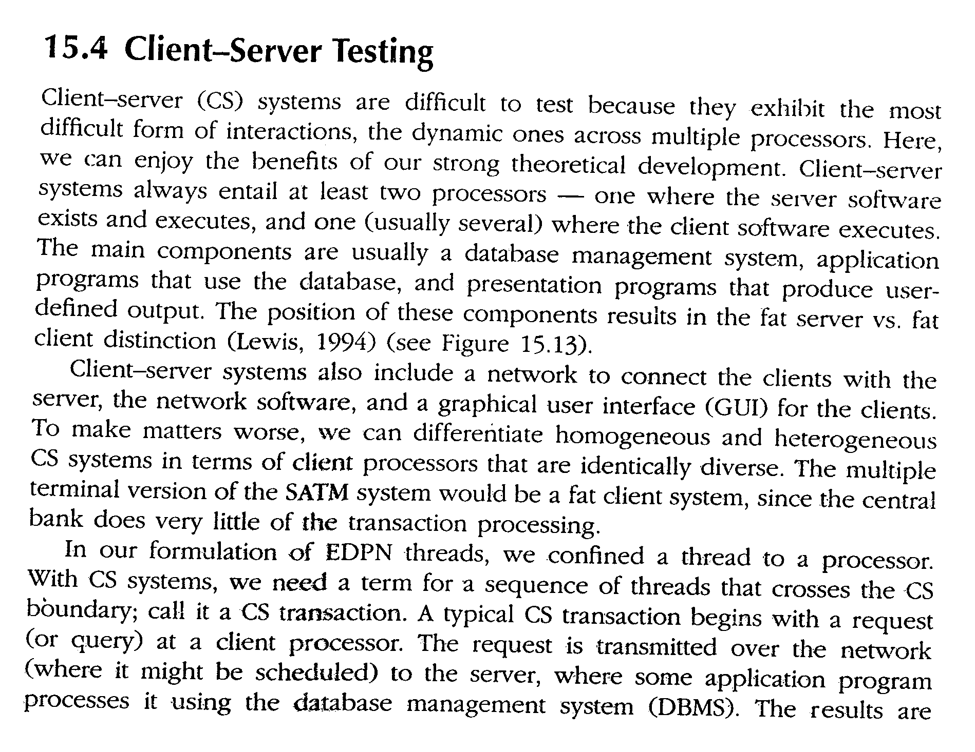

Slide 19
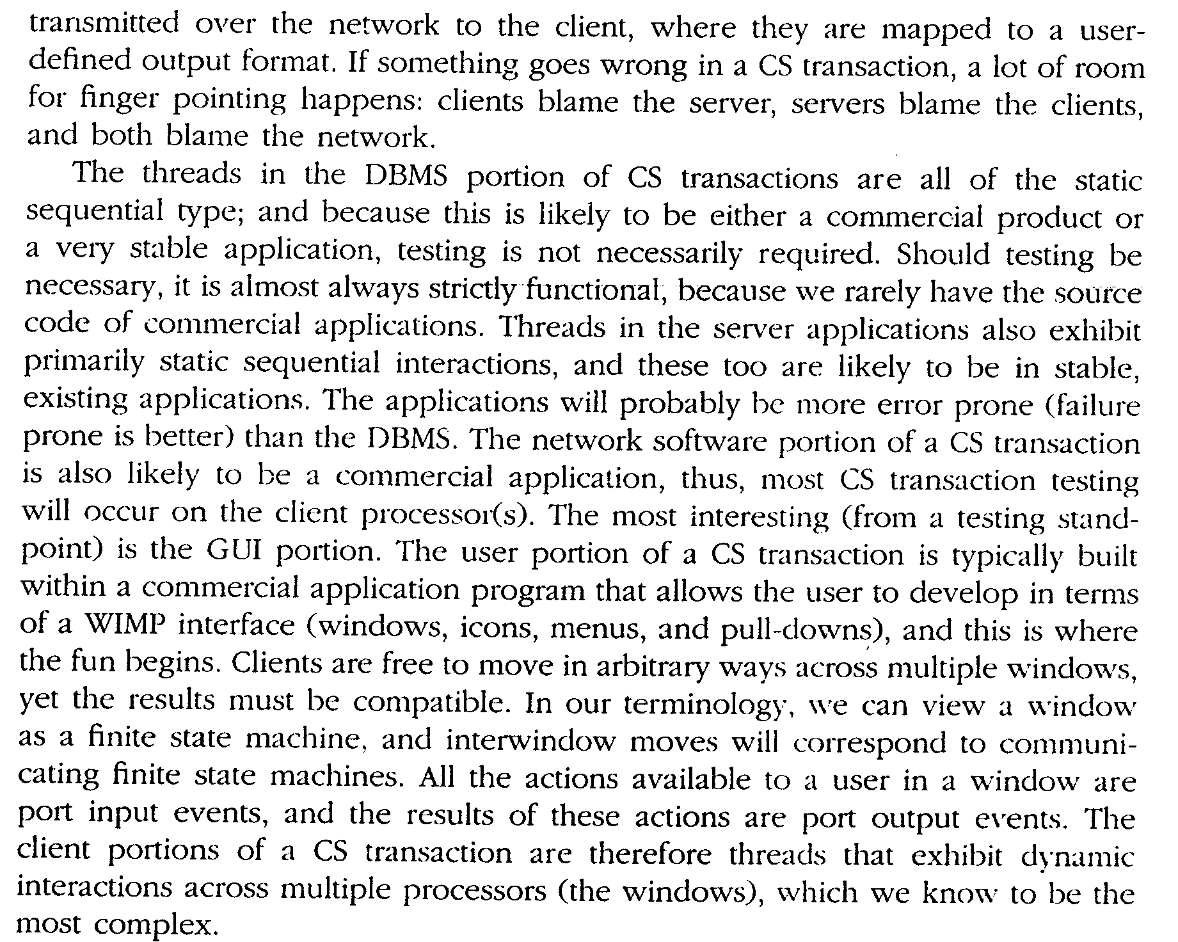

Slide 20
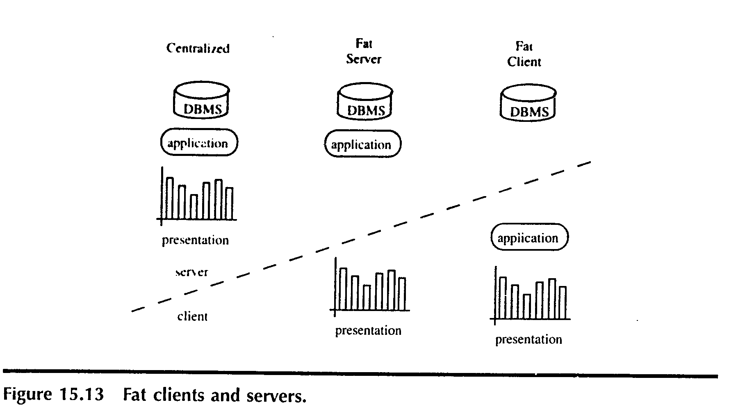

Slide 21
